Slide 1
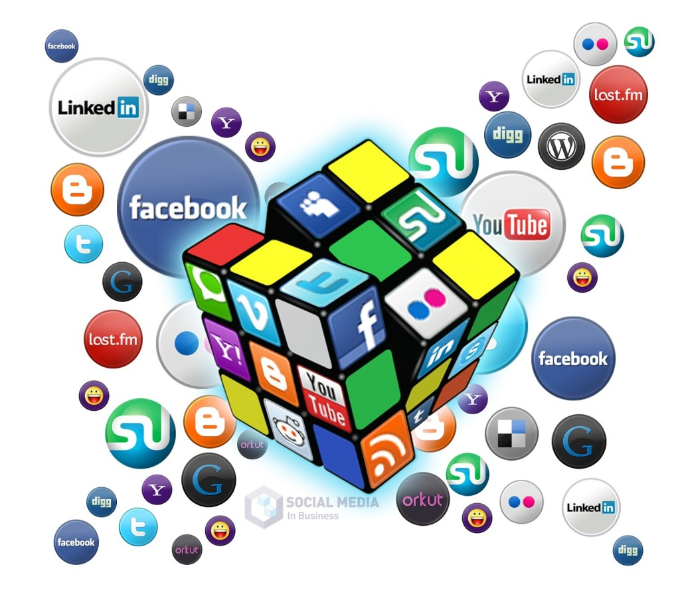
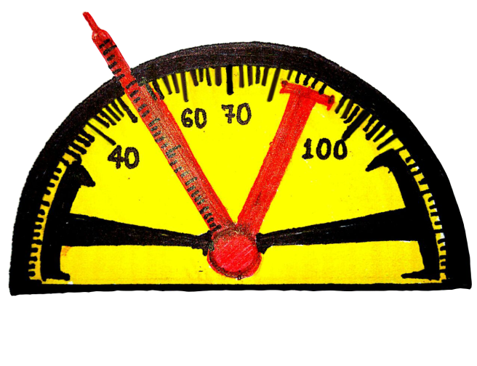


Online social media
workshop
PROJECT -
THE VIRAL TIMES

Slide 2
OBJECTIVES
1
To study and analyze various public pages on Facebook related to a particular youth-event on a given set of parameters.

Slide 3
2
To identify which amongst all collected, can be termed as the most authentic and popular page of that respective event.
3
To identify the most viral page related to a particular event on the basis of graphical analysis.

Slide 4
MOTIVATION
Many pages are there pertaining to any youth event on Facebook
User gets confused: Which page should be followed to get updates
We help user to know the most popular page of particular youth event
1
2
3

Slide 5
Methodology
Data Collection
Data Storage
Data Visualization

Slide 6

Data Collection
Identified prominent youth based events!

Slide 7

Used Facebook graph api to extract data.

Slide 8
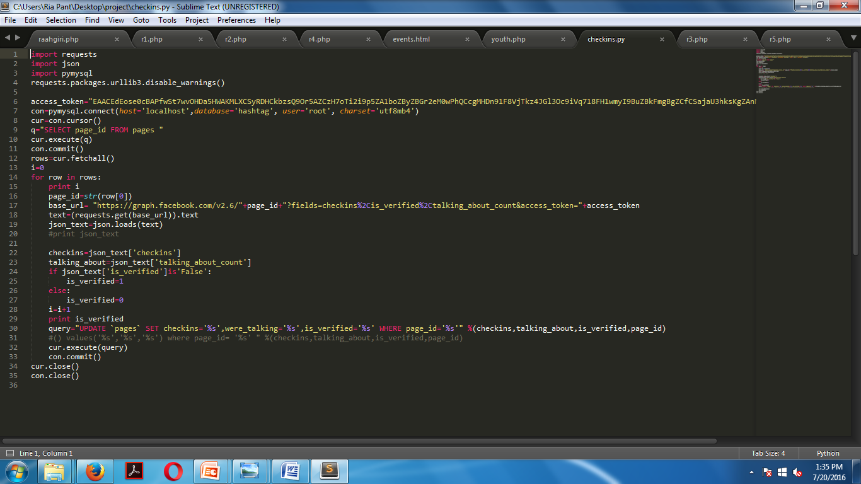
Connection to database.
Ran python scripts

Slide 9
Methodology
Data Collection
Data Storage
Data Visualization

Slide 10
DATA STORAGE
XAMPP
Local web server
Server application: Apache
Database: mySQL

Slide 11
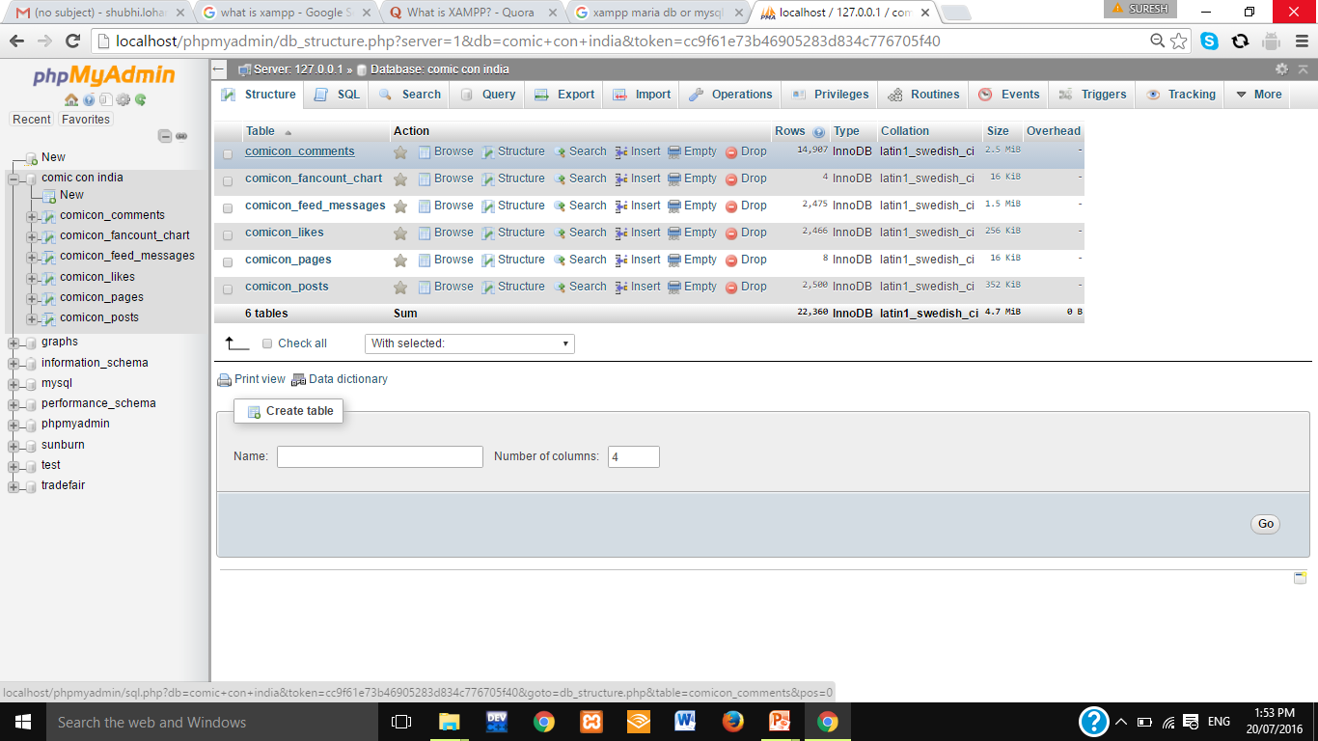
Tables in
Comic Con Database

Slide 12
Methodology
Data Collection
Data Storage
Data Visualization

Slide 13
DATA VISUALISATION
Webpages: HTML & CSS
Google charts
HTML
Graphs: Php Code

Slide 14
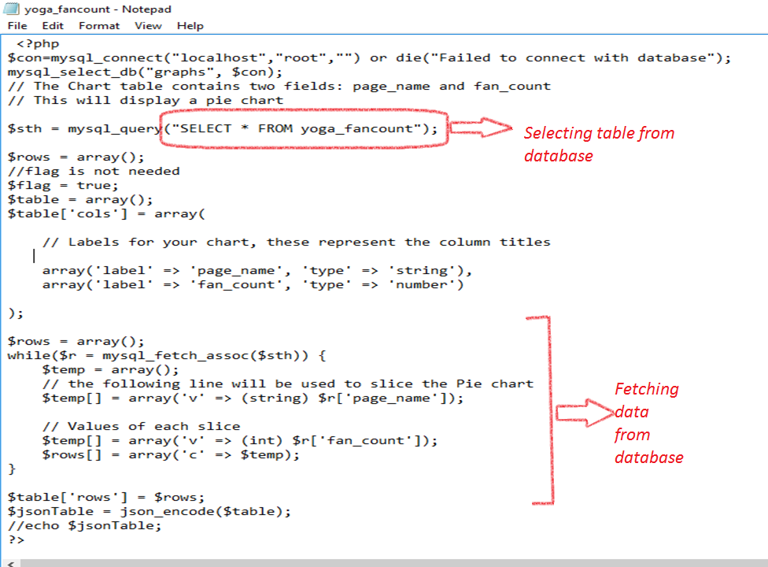

Slide 15
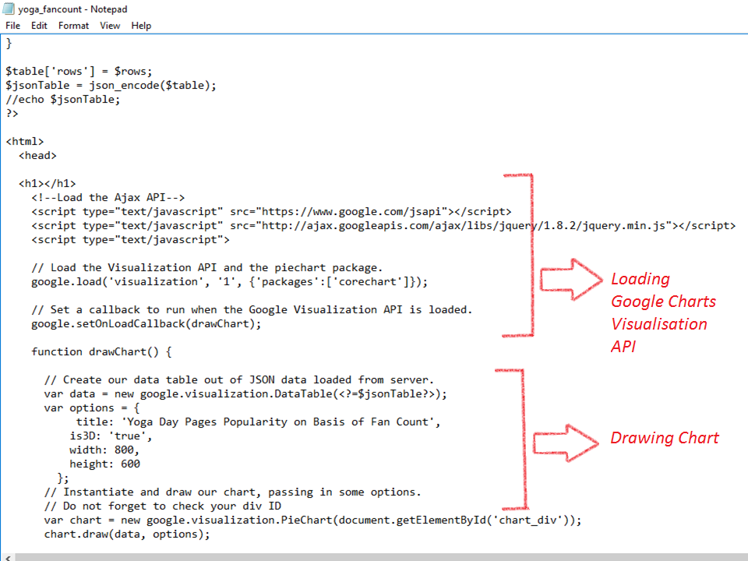

Slide 16
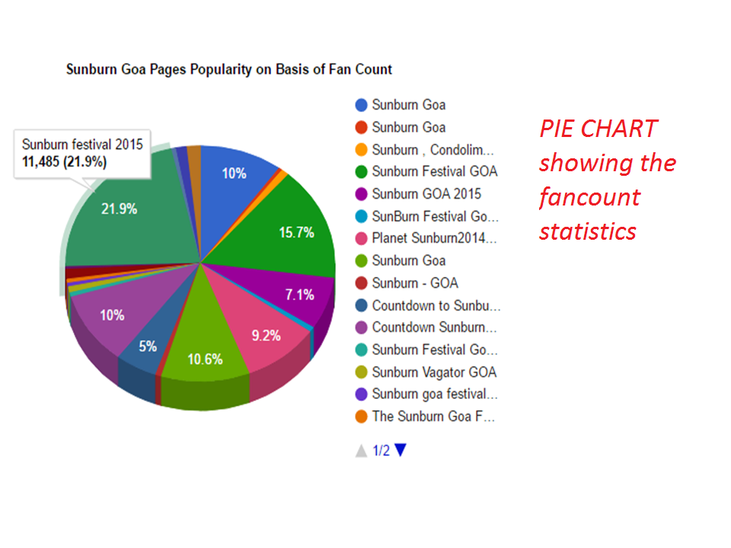

Slide 17
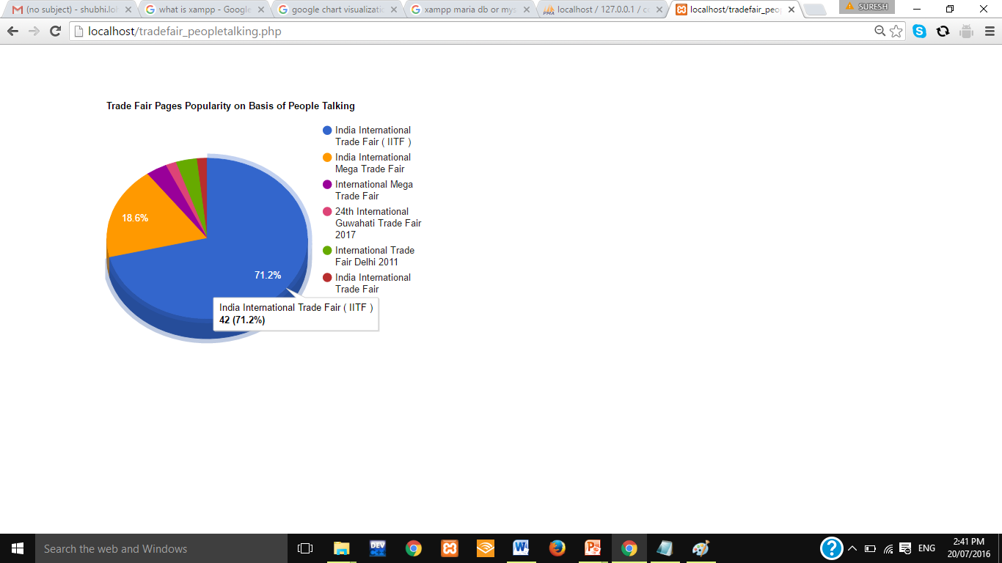
Example of another pie chart showing
Number of people-talking

Slide 18
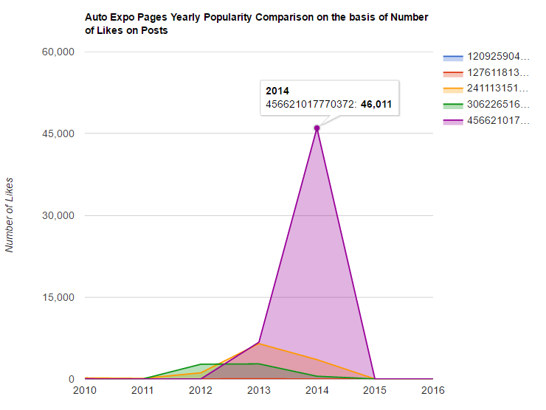
Area graph
showing
no. of likes
yearly

Slide 19
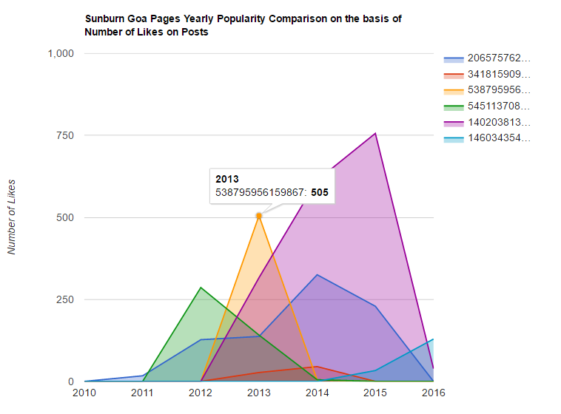
Another
area graph

Slide 20
Web pages
HTML
Bootstrap
CSS
Hypertext markup language used to built web pages
Cascading Style Sheet used for describing the html document
HTML,CSS,JS framework used to built responsive web sites.

Slide 21
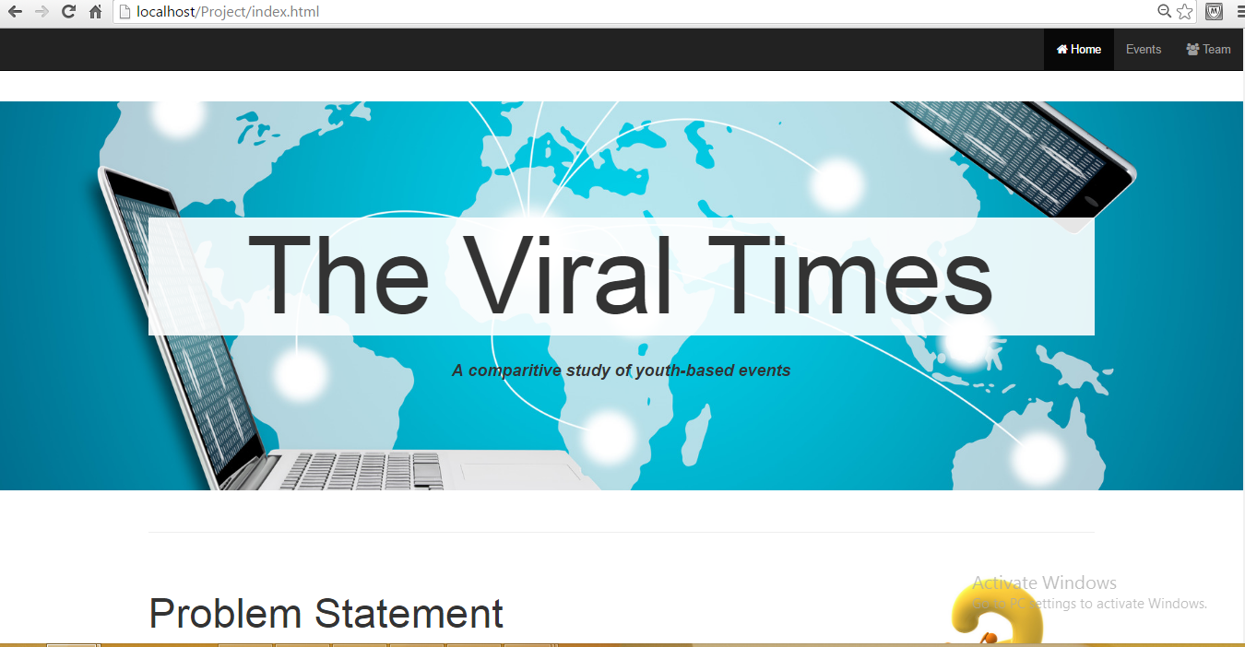
HOME PAGE

Slide 22
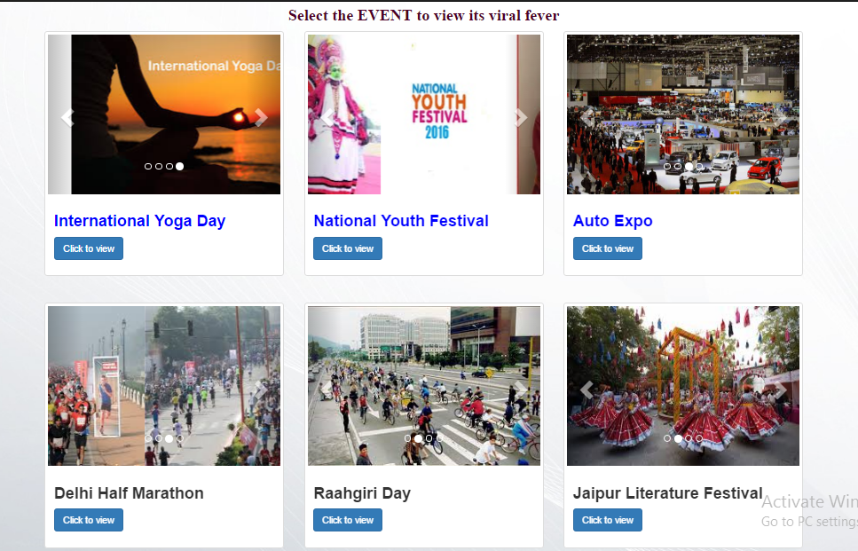
Events Page showing all the nine events

Slide 23
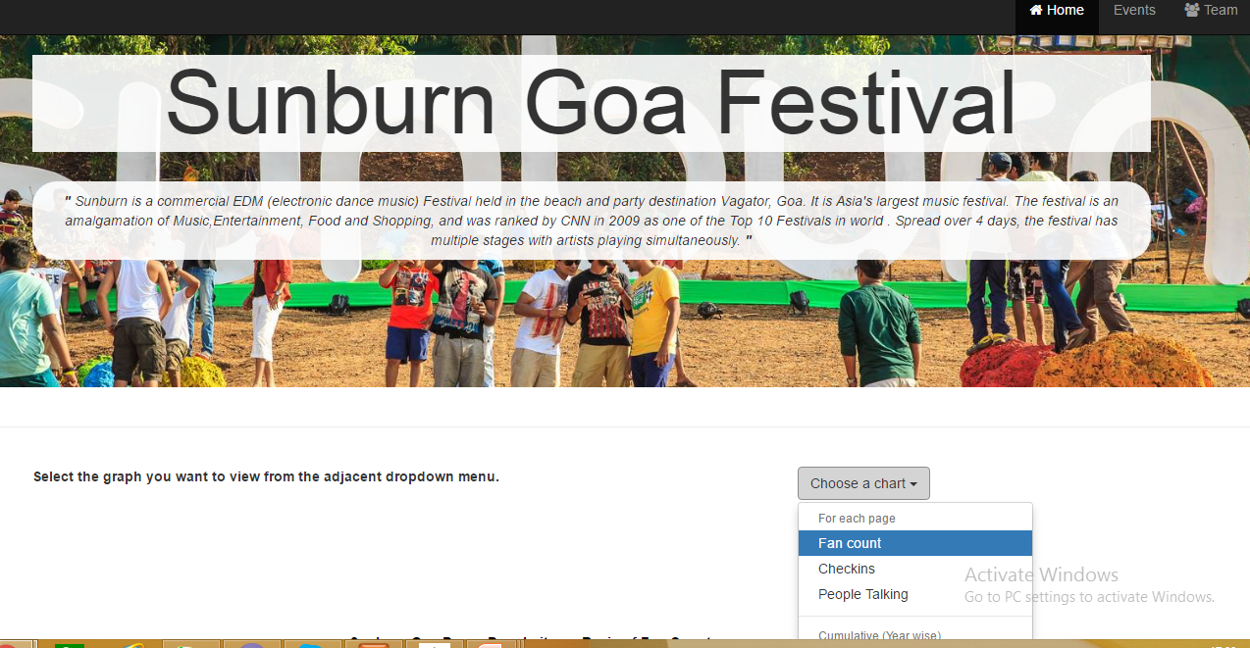
User selects option from the drop down to see the graph

Slide 24



Application
General public
Active and most popular page
Active and most popular page
Which page to follow to remain updated about the particular event
Notes:
As my friends have already told you about the methodology of our project and we have also seen the demo of our webpages ,lets move forward to see the applications of this project .first of all our project targets to the general public .Mostly we all are the facebook users, so it is useful for us as we can easily find out through this analysis which page is the most active and most popular related to a particular event .after we have find out that ,we can easily follow that page to get the regular updates about the event instead of getting confused which page shud we follow and end up getting the wrong information about that event.

Slide 25




Marketing
Firms
Searching Page who has max fan count
Page targeted to popularize the brand
Profit
Database
Notes:
Next we have targeted the marketing firms . Nowadays , all companies use social media for their product advertisements.So it is also helpful for them .through this project we can easily find out which page has max fan count .the output of this search will b the fb page with max fan count.so we can tell the company to target this page to popularize their brand to gain the max profit.

Slide 26
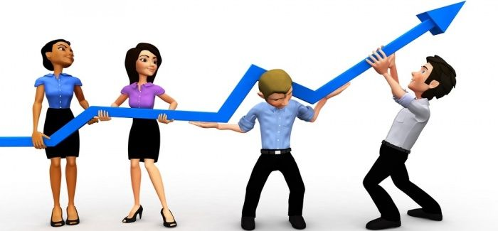
Advancements
Notes:
Now lets see the advancements that we can include in our project in future .

Slide 27

Dynamic collection of data
Enters
keyword
Python
Scripts run
db
Webpage textbox
MORE RELIABLE
Notes:
Till now whatever graphs u have seen on the web pages they are made using static data which is already stored on the databases.
Users can enter the name of the event under analysis on the webpage textbox.
Then the python scripts will run and data will be collected thrugh the public pages of that event and stored on the database using xampp .

Slide 28

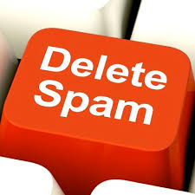
Spam Detection
Detect spam posts on facebook pages
Authencity of the page
Notes:
We can also detect the spam posts on that public page ie wheter or not a particular post is related to that page or not .
Through this analysis we are able to check teh authenticity of the page .

Slide 29

Future Scope
The viral times is not only limited to events, it can also be extended to perform real time analysis.
To find the most viral page for a particular sitcom, any celebrity and many more.
The scope of this project is immense.
Notes:
Let me tell you the future scope of this project.

Slide 30
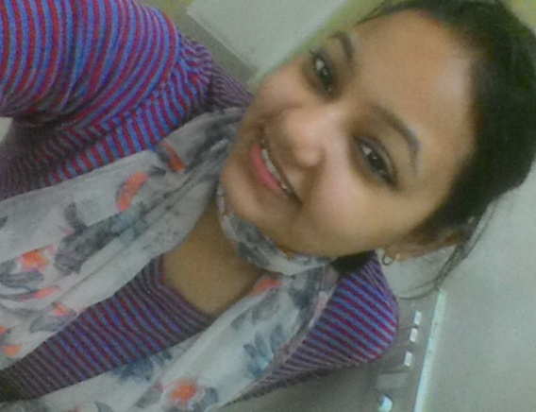
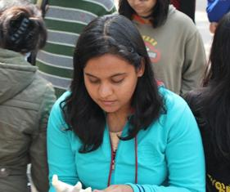
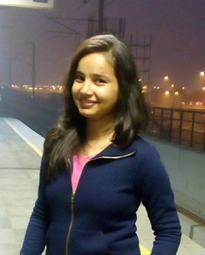
Team Members
DEEPIKA VARSHNEY
MTech
Information Security and Management
MITANSHI RASTOGI
BTech
Computer Science and Engineering
SHUBHI LOHANI
BTech
Computer Science and Engineering

Slide 31
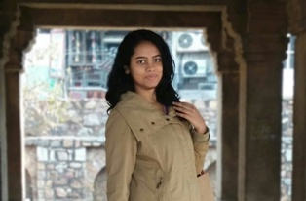
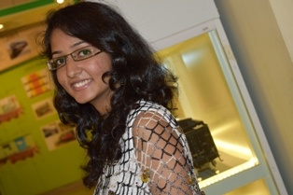
Team Members
RIA PANT
BTech
Computer Science and Engineering
SONALI BANSAL
BTech
Computer Science and Engineering

Slide 32
THE VIRAL TIMES
Thank You

